Slide 1

Global Group of Institutes
SUMMER TRAINING PRESENTATION
On
Website for using HTML & CSS(MyBook.com)
Submitted By:
Tej Narayan Sah
(C3) (2130314)
Submitted To:
Dr. Meenakshi Sharma

Slide 2
Table of contents
1
Introduction
2
Homepage
3
Sale Page
4
Best seller page
5
Contact Us page
6
About Us page
7
Sign Up page
8
Login page
9
Footer Design

Slide 3
Introduction
Our Mission
Key Features
MyBook.com provide us an abundance of books and ongoing literacy support to families and their children from birth and serves as a model for communities committed to ensuring that children are lifelong readers and learners.
1.Free delivery with order tracking
2.Cash on delivery as one of the payment method is available
3.valuable products are available at very cheap cost
4.Additional discounts should be there for most visitors
5.Flexible delivery dates
Our Vision
Our vision is of a world in which reading, learning, and access to information are considered rights, not privileges, so that all children thrive.

Slide 4
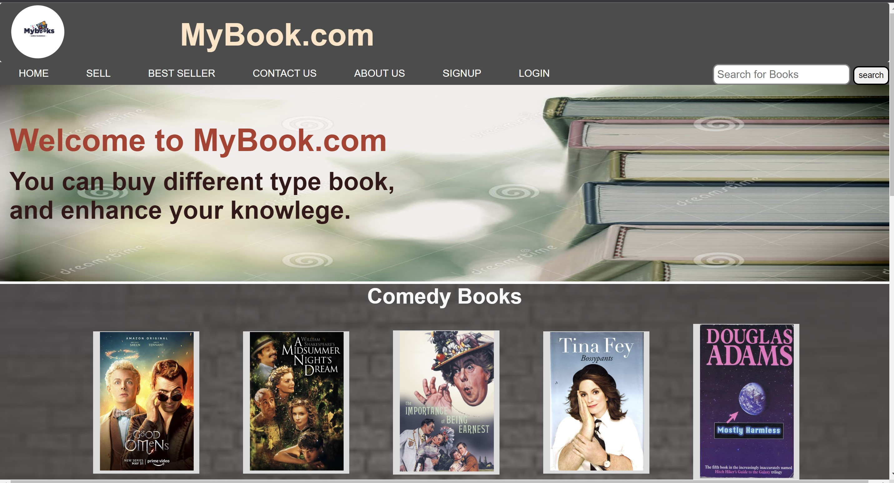
Homepage

Slide 5
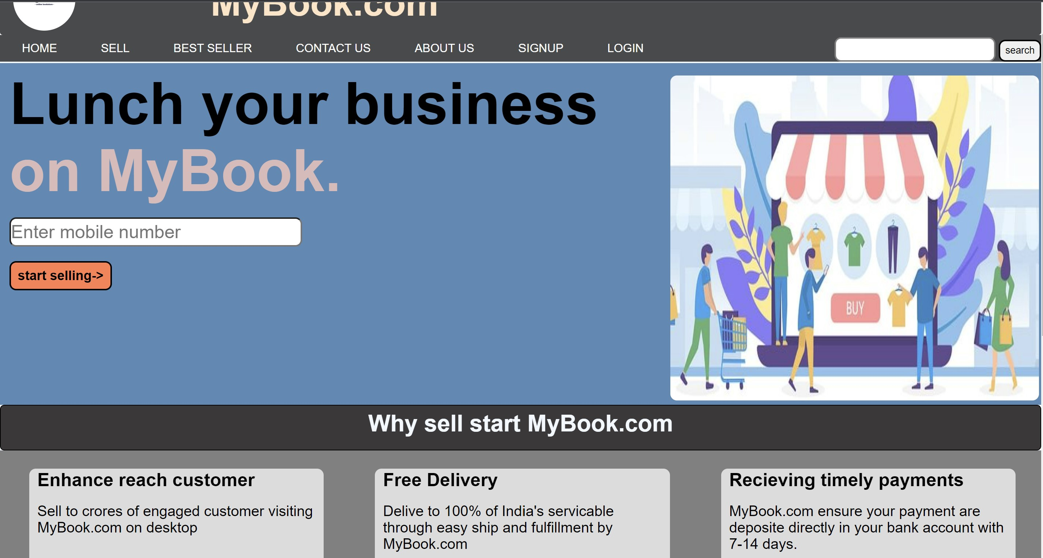
Sell page

Slide 6
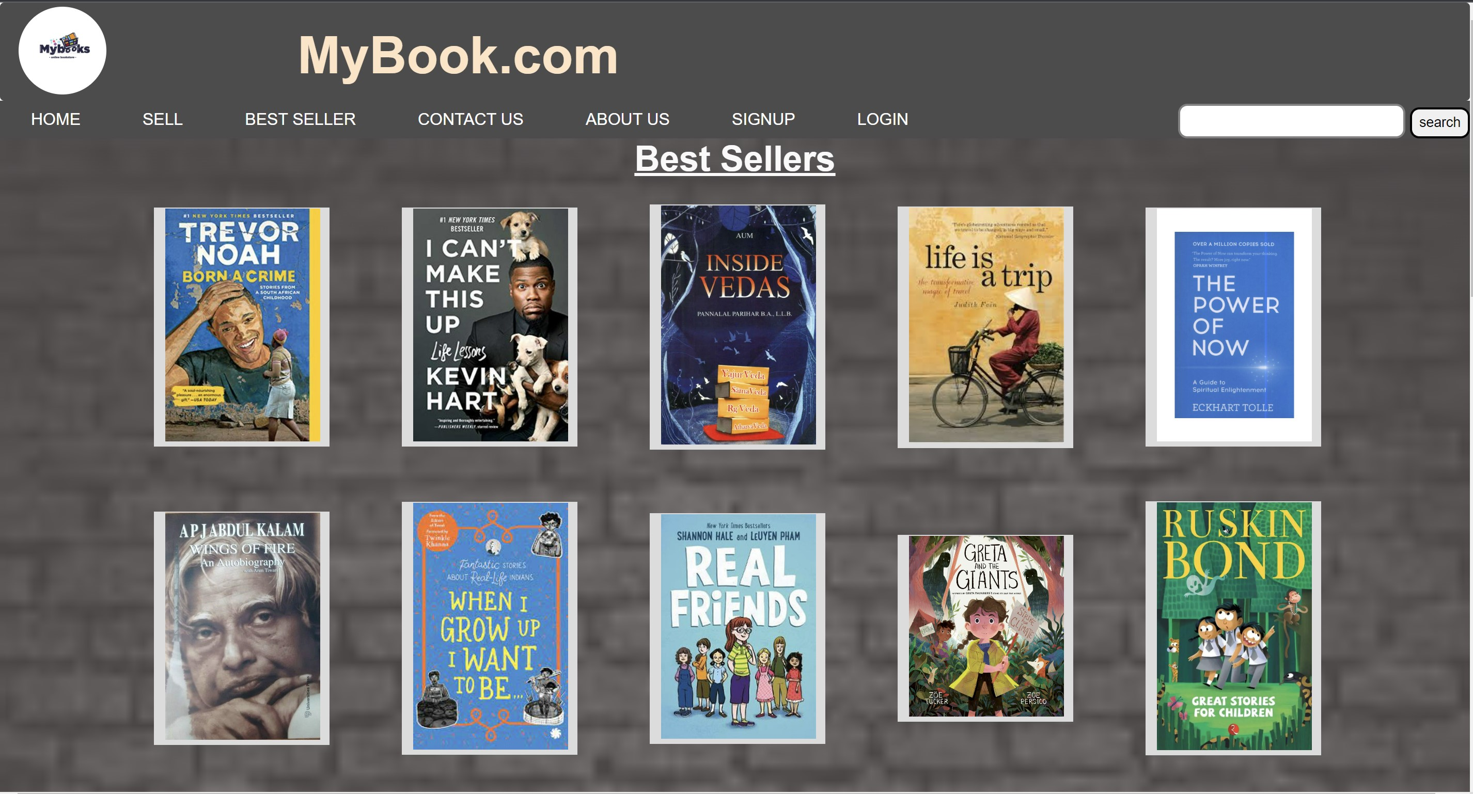
Best seller page

Slide 7
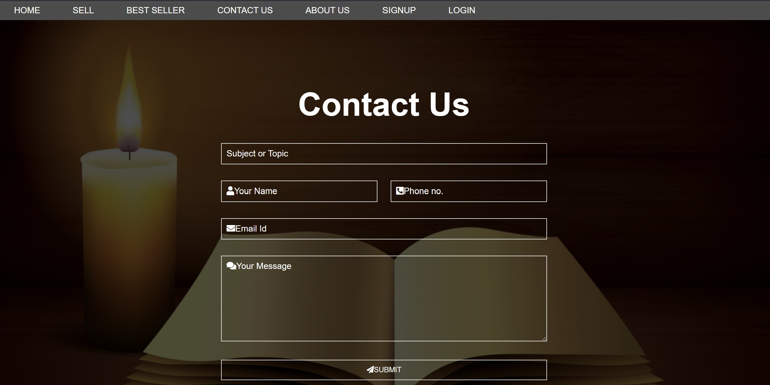
Contact Us page

Slide 8
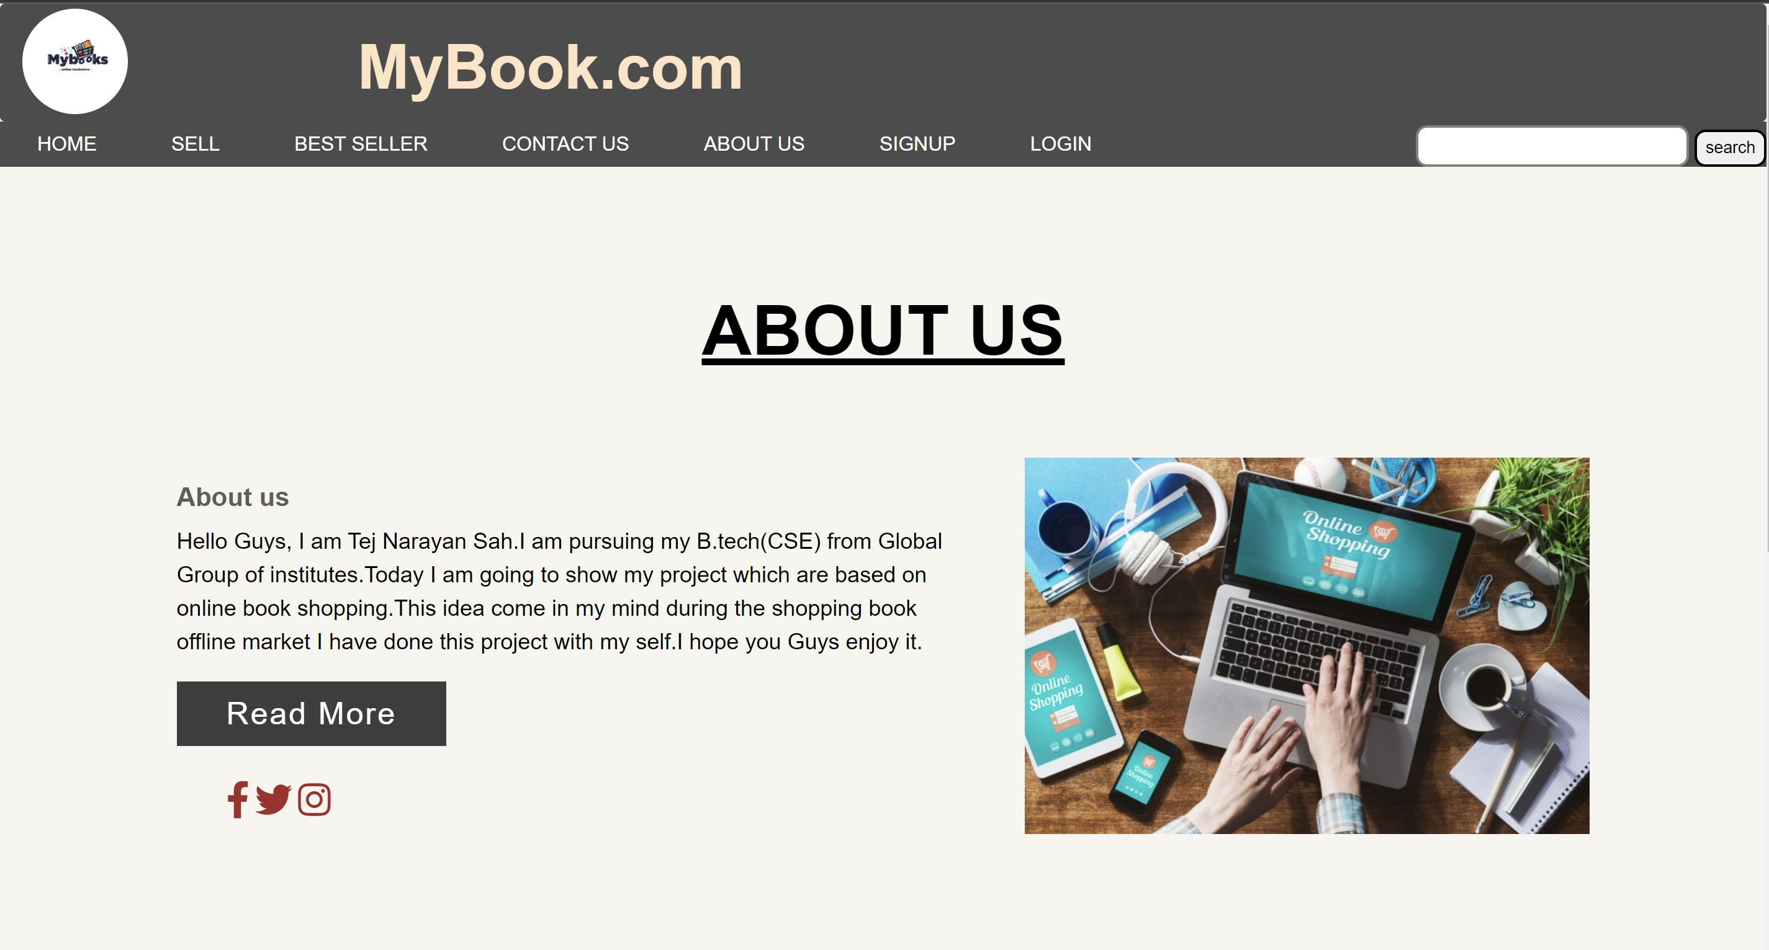
About Us page

Slide 9
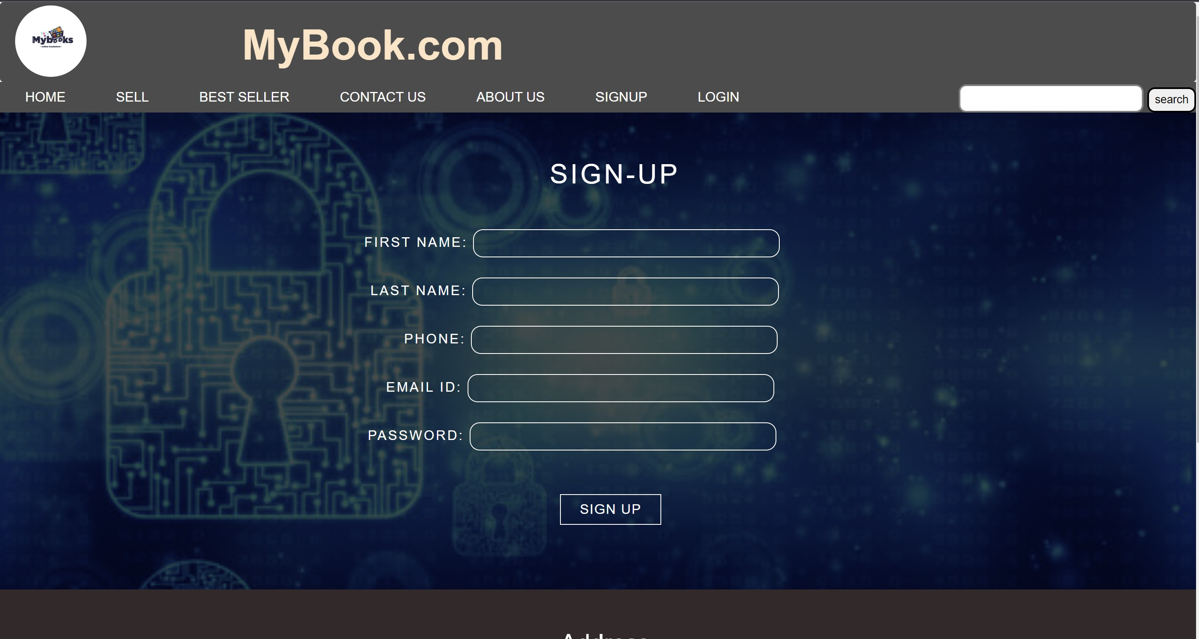
Sign-Up Page

Slide 10
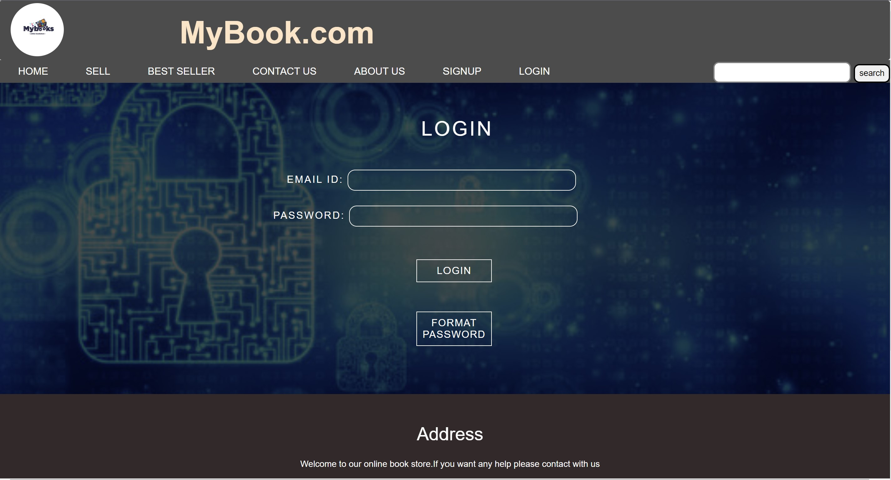
Login Page

Slide 11
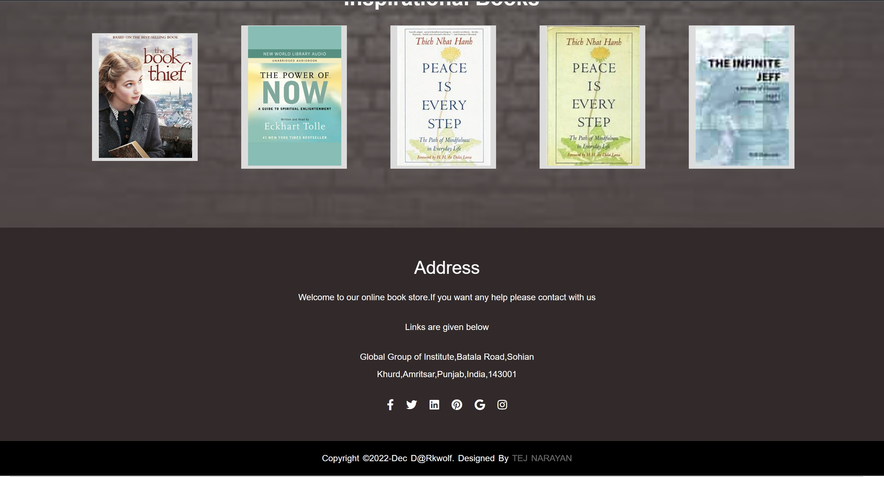
Footer designs

Slide 12
Thank You…

